Slide 1

GE Predix InSight Reporting Services Revenue Models & Strategies

Slide 2

API Monetization Models
Different Audiences for Reporting…
One size does not fit all.
Authors
Consumers
Application Developers
End Users
Report Creators

Slide 3
API Monetization Models
What they are trying to accomplish
Present information and content in easy-to-consume ways
Deliver rich & interactive experiences to their consumers
Quick time to market
Avoid headaches (no time to struggle with complexity)
Authors
Creating
Value they receive
Easy-to-use authoring tools
Aesthetically pleasing content presentation
Easy-to-consume APIs
Can quickly create products
Application Developers
Report Creators
What they are willing to pay for
Access to authoring tools
Mature operating platform (you run it!)
Training & Examples
Membership in a community of like-minded individuals
Early access to needed features

Slide 4
API Monetization Models
What they are trying to accomplish
Explore information to obtain insights
Discover trends & patterns
Optimize and manage situations
Prevent problems
Take advantage of opportunities
Consumers
Consuming
Value they receive
Aesthetically pleasing content
Flexibility to work with any device at any time (mobile, desktop, web, etc.)
Reliability & Performance – it just works
Confidentiality & Security
End Users
What they are willing to pay for
Applications and tools that provide the above value
Resiliency & Availability of information (backup, storage)
Access to historical information (how long can you keep their information?)
Advanced features (social sharing, location-awareness, etc.)

Slide 5
API Revenue Models
Free
Freemium
Pay-as-you-Go
Unit based pricing
Revenue share
As an upsell
API Revenue Models
Tiered pricing
Subscription

Slide 6
Free Model
Strengths
Everyone loves free
Manageable customer expectations
Low friction adoption
Challenges
Delayed revenue
Converting free users to paid users
Paying for costs
Who should get access to “free”?
How long is it “free” for?
How do you convert “free” users to paid users?
What’s included in “free”?

Slide 7
Pay-as-you-Go Model
Key Considerations
Strengths
Challenges
Can lead to complex pricing
Difficult for consumers to predict costs & budget
Commoditizes your offering
No lock-in to a subscription
Can charge customers a premium in exchange for low commitment
Low customer commitment required
Why pay-as-you-go?
Pay for only what you use
What do you charge for?
Authoring reports
Discounts for features you use most
Report generation
# online reports generated
# of PDF pages generated
Access to advanced reporting features
Per month per user (report author)
Variations
Prepaid discounts
Flat fee per month for N units
Next N units additional cost above that
Next N units additional cost above that…
Tiered Pricing
Freemium (first tier is Free tier)

Slide 8
Subscription Model
Key Considerations
Strengths
Challenges
Flexible to accommodate different types of users
Predictable monthly costs for consumers
Predictable revenue for the business
Upsell opportunities
Higher commitment level required of consumer
Consumer is locked-in for period of time
Difficult to change pricing during subscription
Determining right price
Why subscription model?
Predictable cost for budgeting purposes and revenue expectations
What do you charge for?
Authoring reports
Discounts for features you use most
Report generation
# online reports generated
# of PDF pages generated
Access to advanced reporting features
Per month per user (report author)
Viewing
# reports accessed
# pages viewed
# API calls
Variations
Basic
Training/consulting?
Enterprise support
High volumes included
Advanced features
Enterprise
Higher volumes
More features
Premium/Advanced
# report views
# report definitions
Volume Limits
Basic Features

Slide 9
Illustrative Pricing Models
Service Name | Features | Price metric | Tier 1 | Tier 2 | Tier 3
Reporting |  | Total users | 1 to 4 | 5 to 10 | 11+
 | Predix Insight Design Studio | Per user/month | $300 | $275 | $250
 | Predix Insight Viewer |  | $30 | $27 | $25
 |  | Total pages generated (month) | 200 | 500 | 1000
 | Report Generator | Per report page generated | $0.03 | $0.02 | $0.01
 |  | Total data delivered per month | 1GB | 2GB | 3GB
 | Report Delivery | GB/month | $0.10 | $0.09 | $0.08
 | Report Storage | * Blob Store pricing | -
Service Name | Features | Price metric | Tier 1 | Tier 2 | Tier 3
Data Federation
 |  |  | 1 | 2 to 5 | 6+
 | Endpoints | per endpoint per month | $100 | $90 | $80
 | Total Data I/O per month | GB/month | 1GB | 2GB | 3GB
 |  |  | $0.10 | $0.09 | $0.08

Slide 10
Subscription Pricing Examples

Slide 11
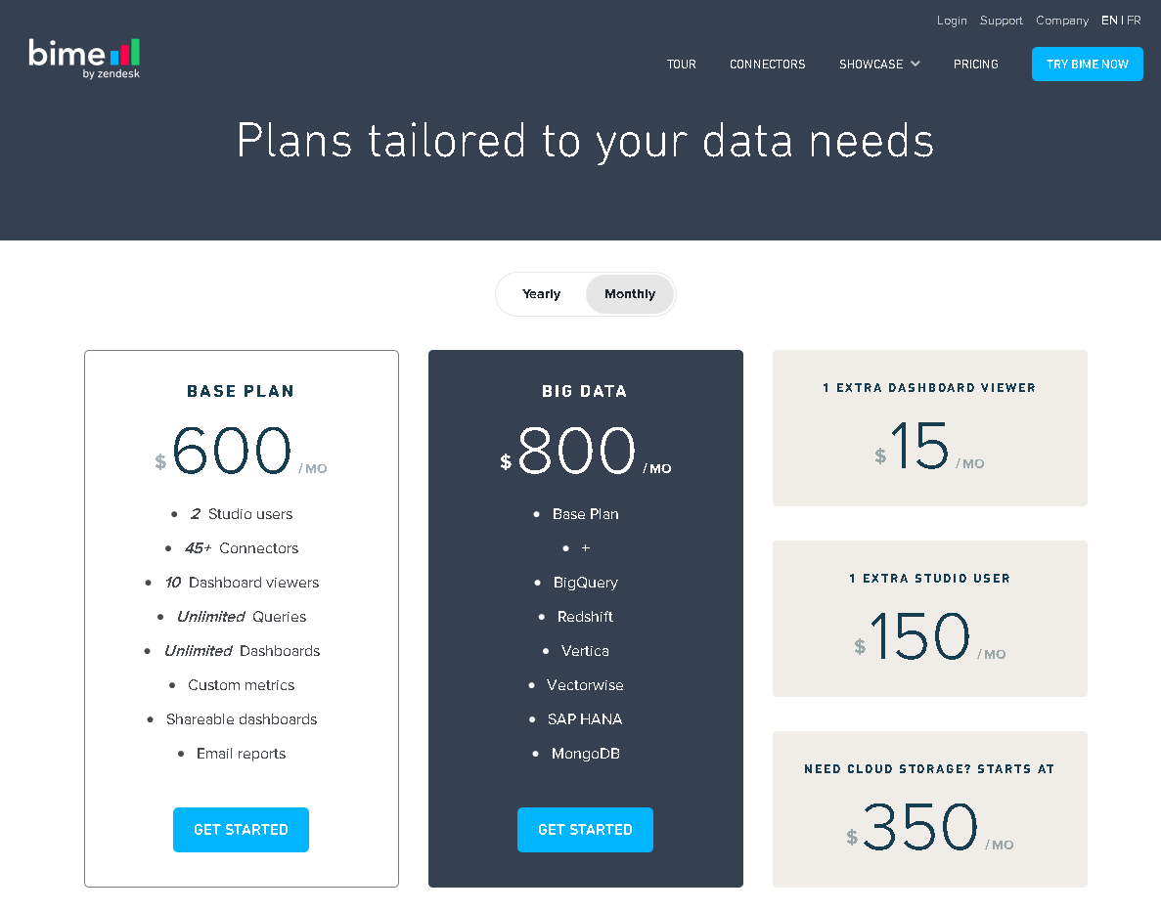
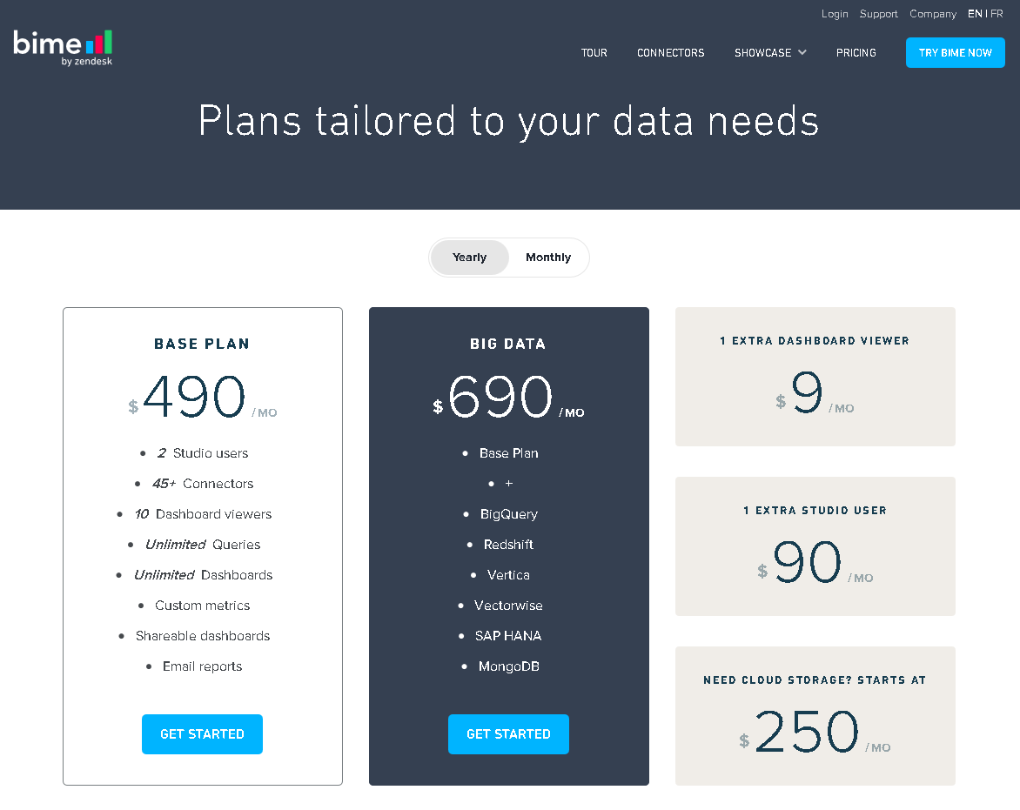
Pricing Example: bime

Slide 12
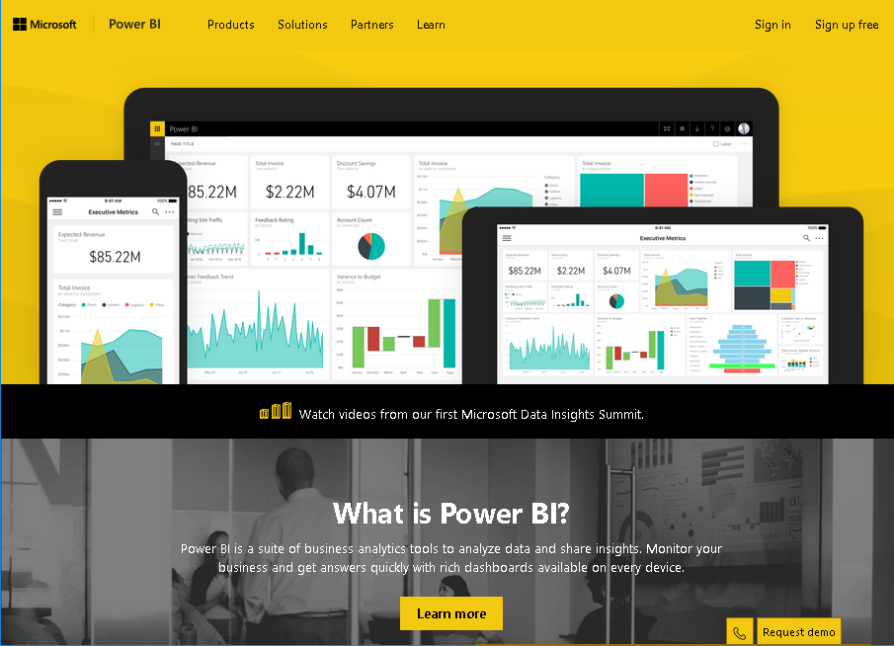
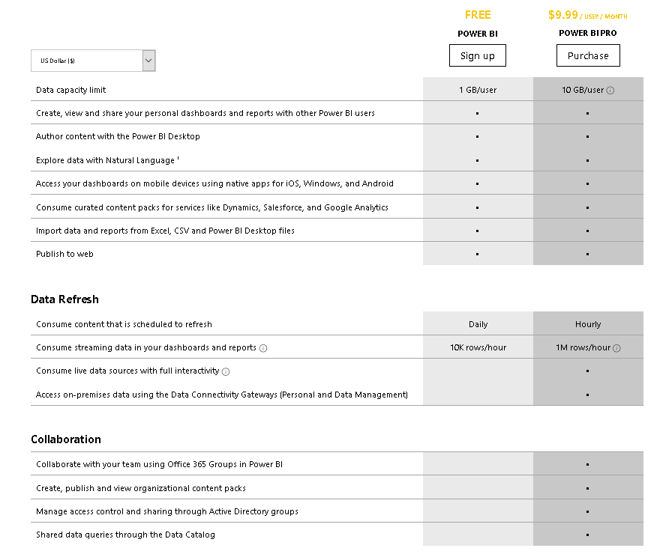
Pricing Example: Microsoft Power BI
Microsoft Power BI

Slide 13
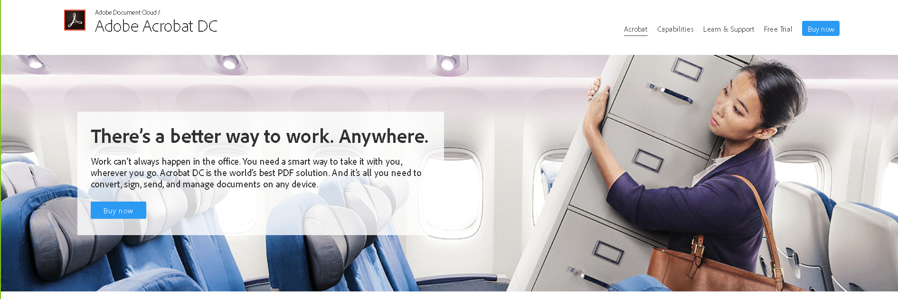
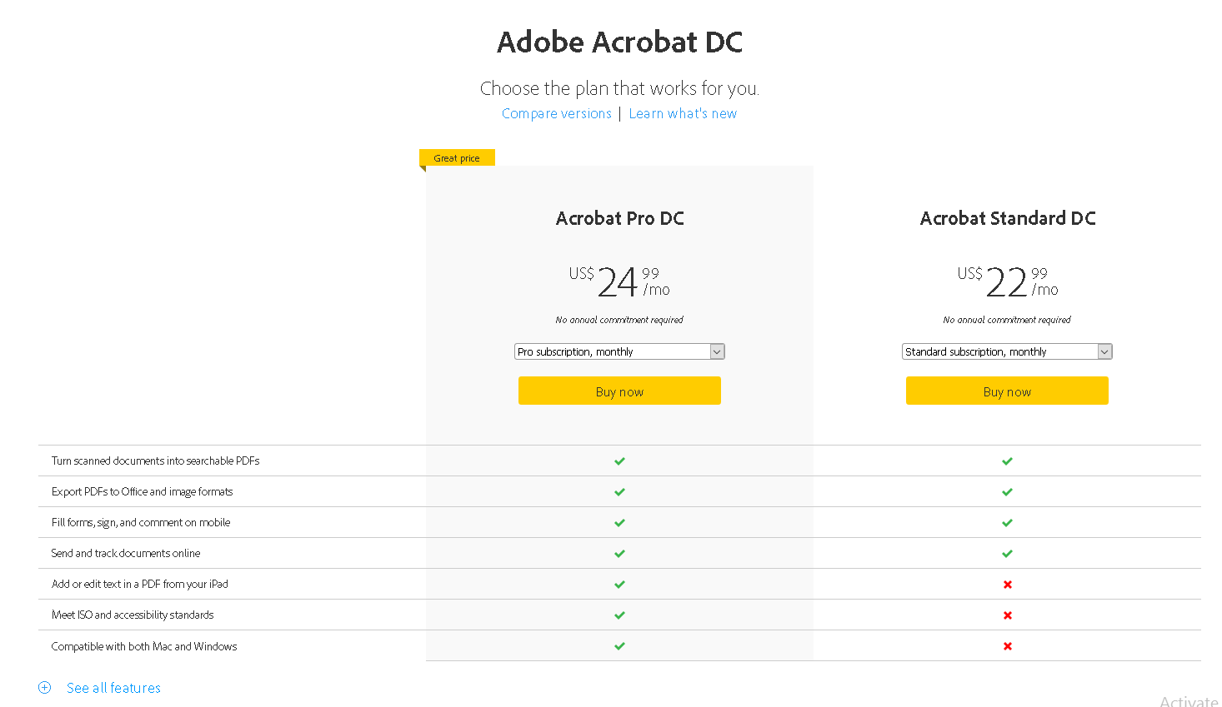
Pricing Example: Adobe Acrobat DC

Slide 14


Slide 15
Appendix I: Business Model Canvas

Slide 16
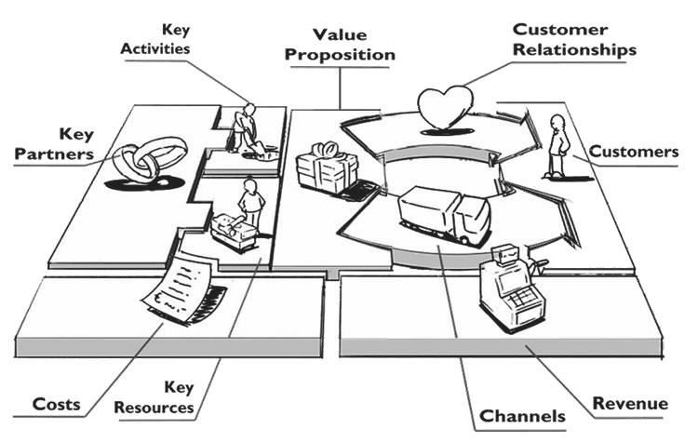
Business Model Canvas
A Business Model describes how you create,
deliver and capture value for your stakeholders
The business model canvas is a tool that helps
you describe and discuss your Business Model

Slide 17
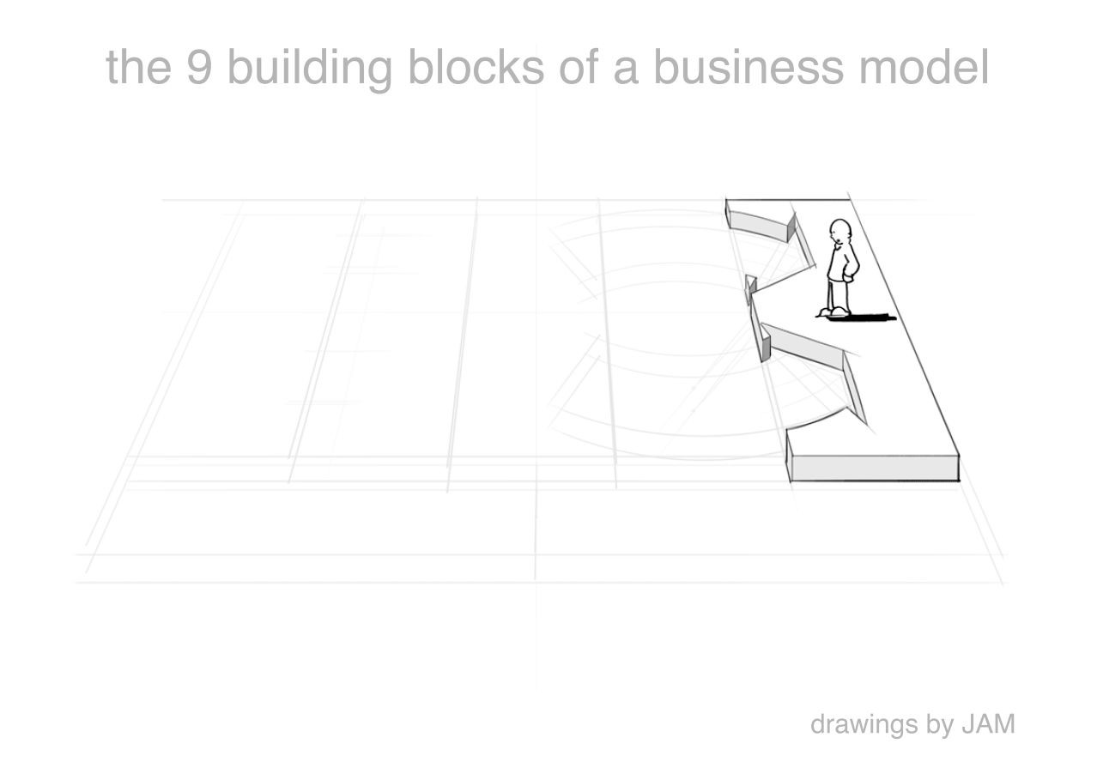
Customer Segments
which customers and users are you serving? which jobs do they really want to get done?

Slide 18
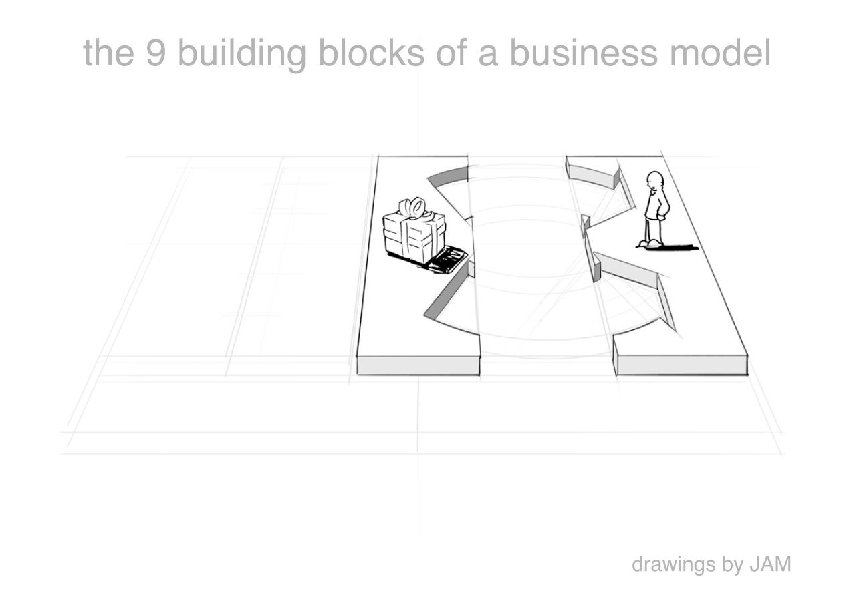
Value Proposition
what are you offering them? what is that getting done for them? do they care?

Slide 19
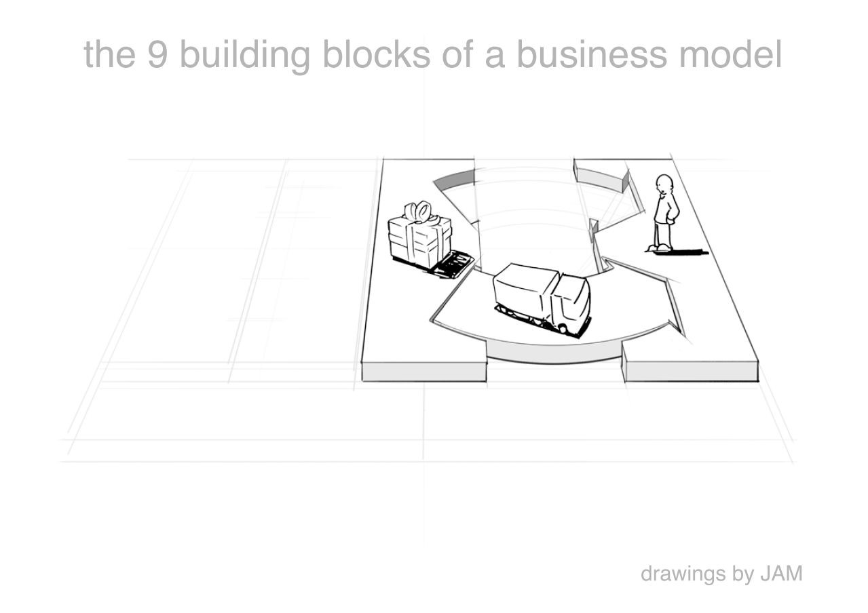
Channels
how does each customer segment want to be reached? through which interaction points?

Slide 20
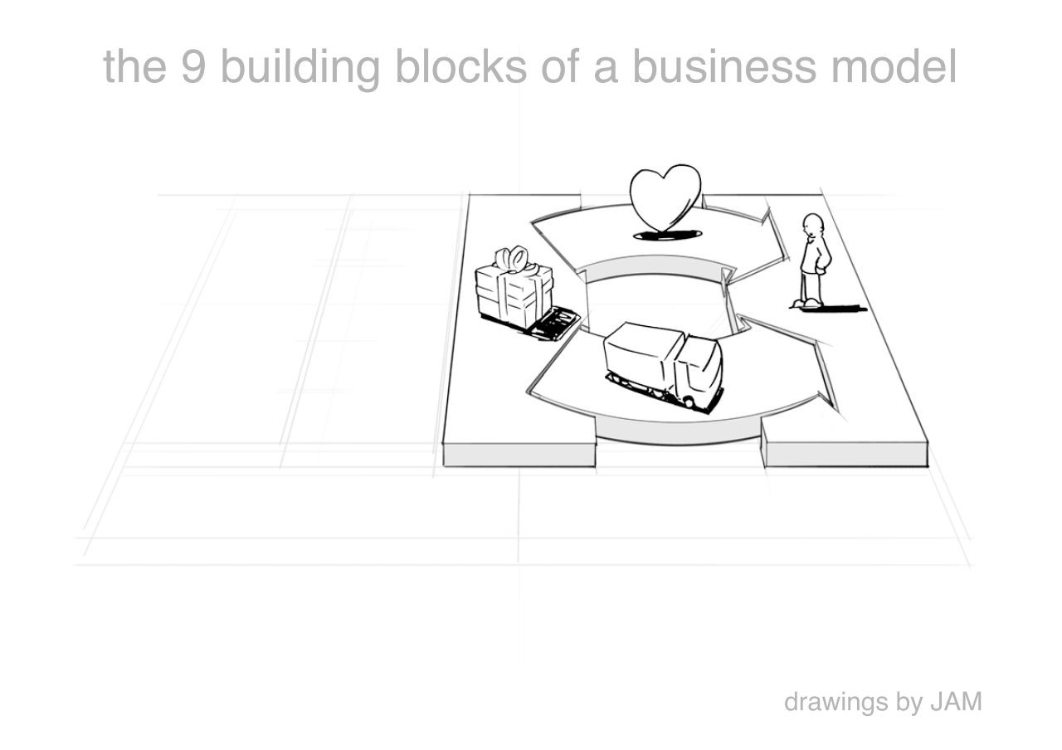
Customer Relationships
what relationships are you establishing with each segment? personal? automated? acquisitive? retentive?

Slide 21
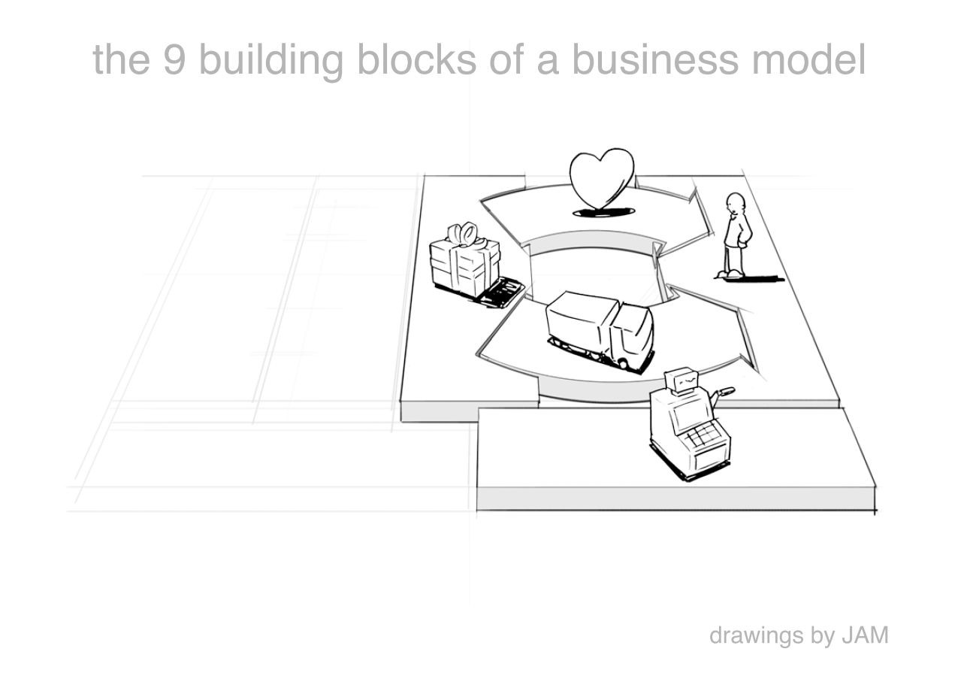
Revenue Streams
what are customers really willing to pay for? how?
are you generating transactional or recurring revenues?

Slide 22
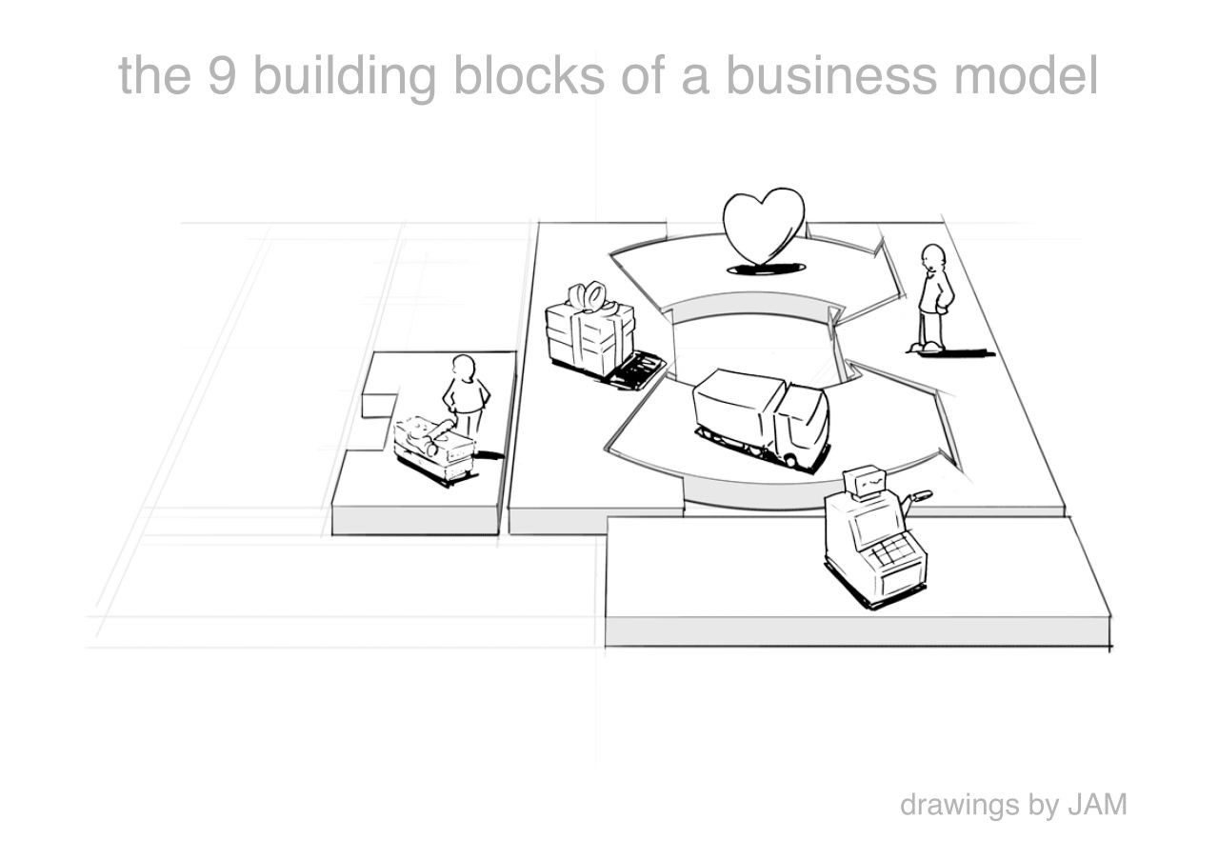
Key Resources
which resources underpin your business model? which assets are essential?

Slide 23
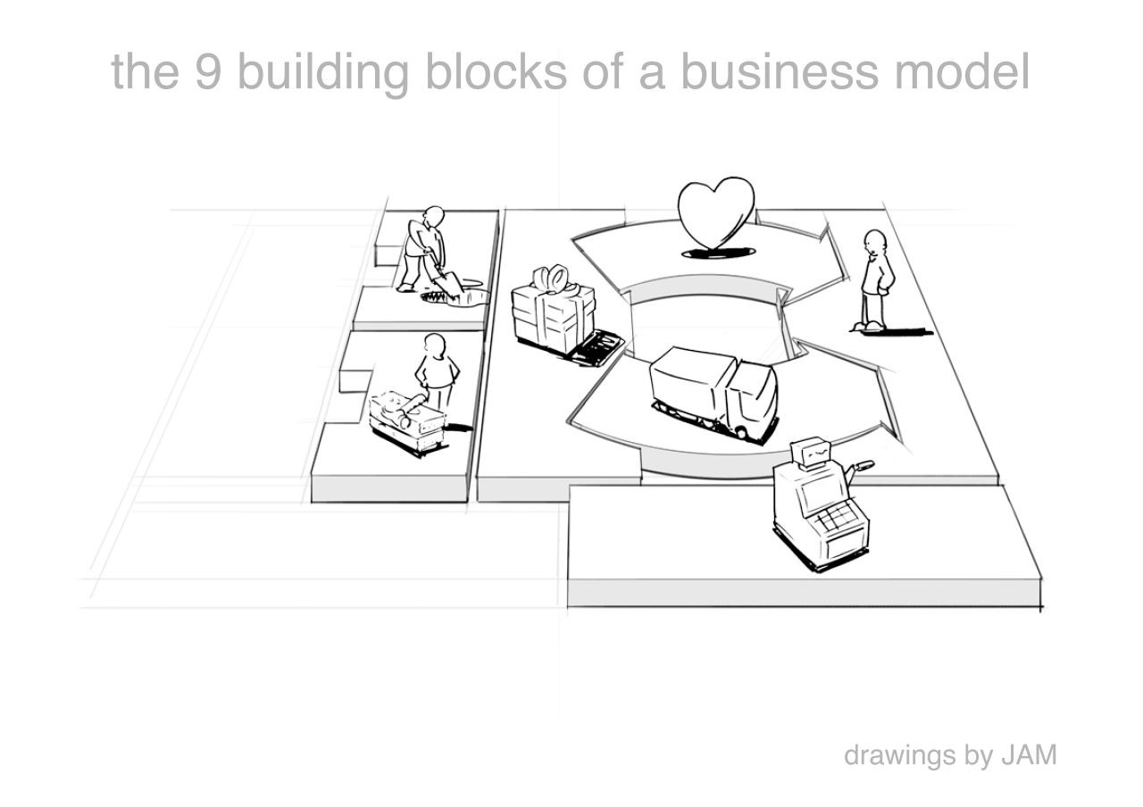
Key Activities
which activities do you need to perform well in your business model? what is crucial?

Slide 24
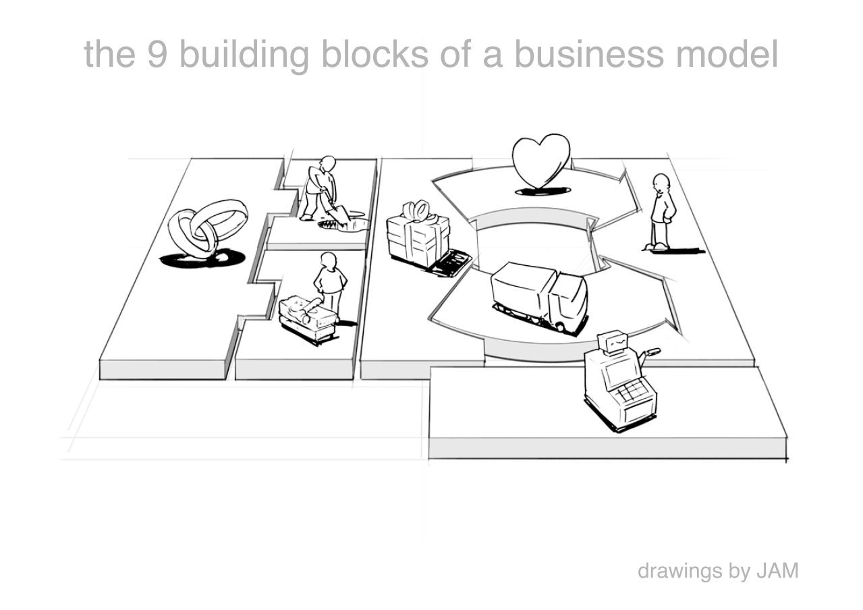
Key Partners
which partners and suppliers leverage your model? who do you need to rely on?

Slide 25
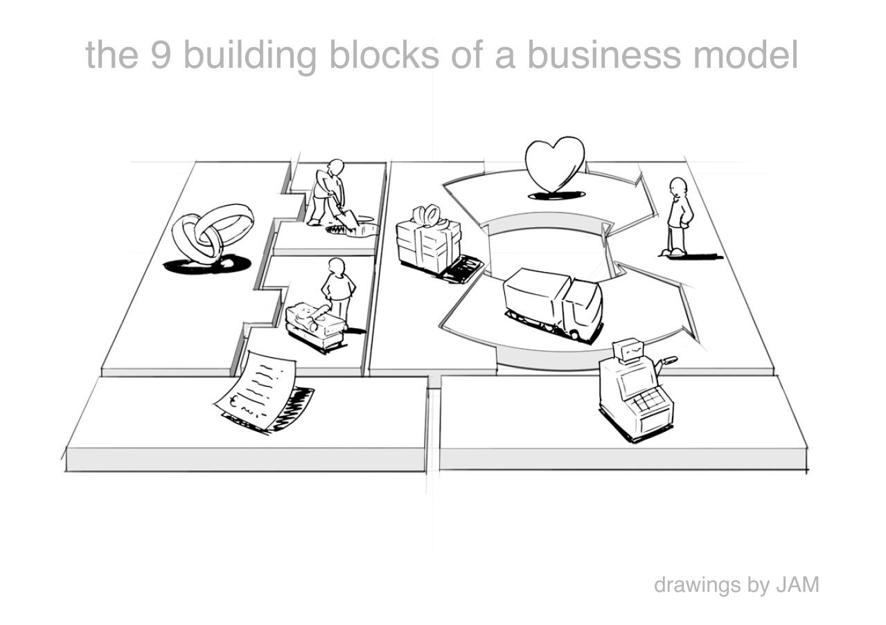
Cost Structure
what is the resulting cost structure? which key elements drive your costs?

Slide 26
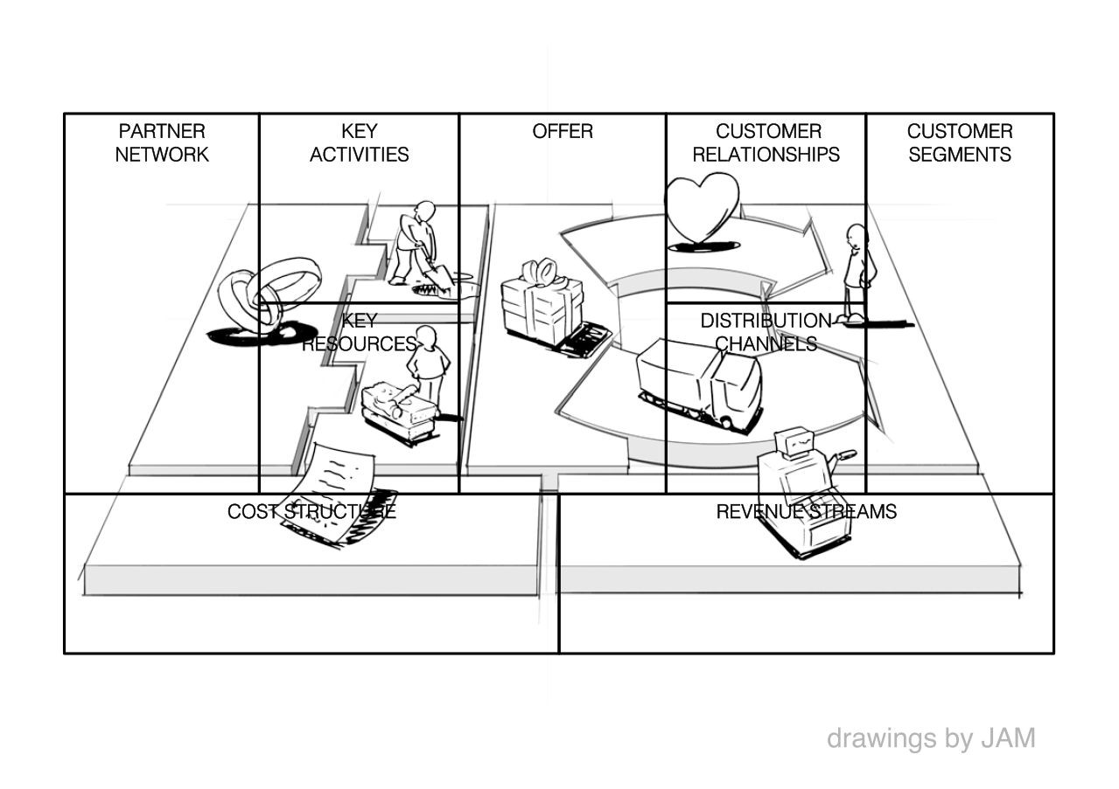
Business Model Canvas

Slide 27
Business Model Canvas (Illustrative)
Key Partners
Key Activities
Value Propositions
Customer Relationships
Customer Segments
Device Makers
Development
Industrial Strength
Premium Enterprise Support
Large Industrials
Design (Product & Service)
Easy to Use
Self-Service Model (individuals, SMBs)
Fortune 1000
Marketing
Visually Stunning
Communities & Forums
Existing GE Customers/Prospects
Mobile
Key Resources
Channels
Brand
Customization
Sales Team
Industrial DNA
Targeted Media
Domain Knowledge
Professional Communities
Cost Structure
Revenue Streams
Marketing
Compute & Storage
Usage Fees
Membership/Subscriptions
Engineering
Ops

Slide 28
Business Model Canvas – Create your Own
Key Partners
Key Activities
Value Propositions
Customer Relationships
Customer Segments
Key Resources
Channels
Cost Structure
Revenue Streams

